Slide 1
Online Entertainment Application
Jay Popat(1685858)
Rajesh Reddy(1682826)
Kartik Savaliya(1686977)

Slide 2
Functional requirement
Application must ask customer to create an account to become a member.After becoming member user can go to any entertainment category.
User should be able to listen the songs.
Users should be able to watch the videos.
Users should be able to play the games.
Users should be able to watch it online as well as could download the videos and audios.
User should be able to select videos or songs in their favourite category list.
When they open the application they should see the task they did before Ex:Listening to song,watching movie,playing game etc.

Slide 3
User must have option in movies to resume from that time if he/she had watched that movie partially.
User should be able to send and accept the request for the game.
Users have to be notified when they are connected to the other players in playing the game.
Users are able to login to website.If they want to login

Slide 4
Non functional Requirement
User and server communication should be fast and reliable without any disturbance to the user.
We have to save the user information data such as email and personal details.
The videos,audios,games should be licensed and should be genunine.
The quality of videos and audios should be better so that user can enjoy.
New videos ,audios and movies should be uploaded as fast as possible.

Slide 5
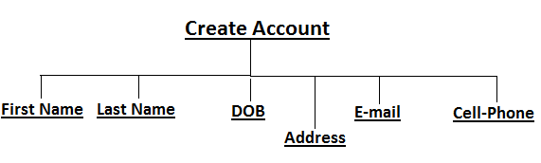
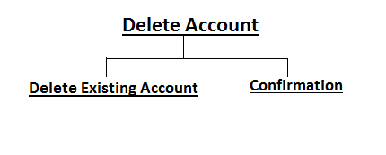
Functions of different Options

Slide 6
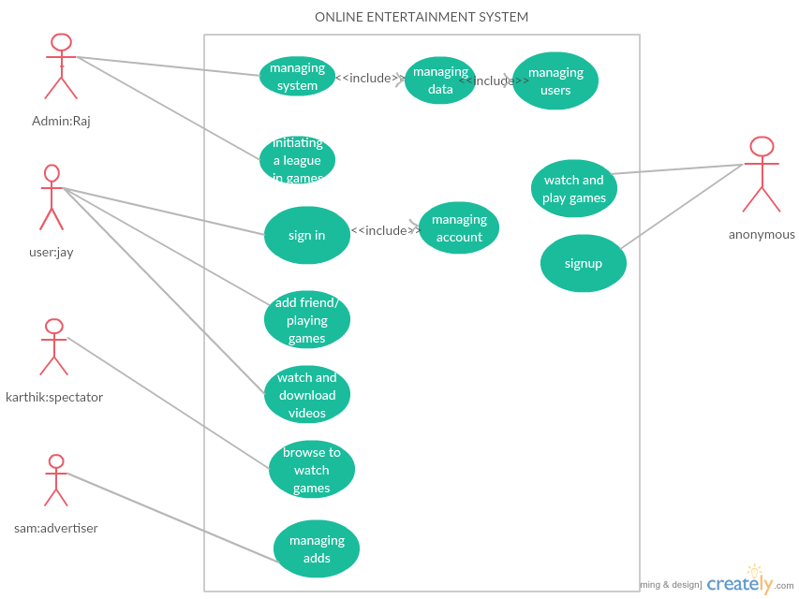
Use case Diagram

Slide 7
The above is the UML use case diagram of our online entertainment system which consists of five actors and the roles of actors are explained below
1. Admin: admin in our system is raj who can edit the data of users and add or remove games and who is the only one to manage system.(he can add or delete videos and audios.
2. User: user in our system is jay who is the registered user of our system who can play games and download the videos or audios in our system.
3. Spectator: spectator in our system is karthik who can able to watch the live on going video games.
4. Advertiser: Sam is advertiser in our system who can manage adds.
5. Anonymous: he or she may be a guest to our system and first time user of our system and who can access to watch the videos and audios and play single player games.(he or she is non registered user of our system).

Slide 8
Use Case Diagram 1
Use case name : Downloading videos.
Participating Actors : initiated by anonymous userCommunicates with the system, admin: Raj.
Flow of Events : 1.Anonymous user visits our website to download some Videos and he clicks the video button and search forvideos
2. He search for a videos and he click the link of thevideo.
3. He watches some of the videos and he wants todownload the video.
4. He clicks the download button which he directed to registering page of the system.
5. He fills the details of his name, Email and other requirefields and click submit button.
6. Admin: Raj validates his data and he sends theconfirmation mail to the user.
7. User: jay activates his account and he will direct to download page and he will download his video. Online entertainment system
Entry condition : anonymous user visits our system.
Exit condition : He downloads his video.
Quality requirements : if user disconnected when download is in progress then user must be able to download his video when he login again.

Slide 9
Use Case Diagram 2
Use case name : creating tournaments.
Participating Actors : raj: admin.user: jay.
Flow of Events : 1.Raj login to the system as a administrator of the system.
2 .As administrator, Raj can create a league in a particular game.(for ex: he creates a world t20 league in cricket game.)
3.After creating a league name with his administrator rights he will send the message to all the users who joined in the system.(about the league duration and rules).
4. After sending the message jay and other users have to register for league (because every league has a limited number of users can play).
5. Raj will create a group with limited number of users and he allows access to users to chat in the chat box.(the chat box will be disabled after the tournament)Entry condition : anonymous user visits our system.
Entry condition : raj login to system..
Exit condition : raj will create a chat box for groups.

Slide 10
Use Case Diagram 3
Use case name : playing games
Participating Actors : user: jay, advertiser: Sam
Flow of Events : 1. jay logged into the system and he wants to play some Games
2. Jay entered into the games menu in the home page and enters into the games window.
3. Jay clicks the particular game (ex: cricket) then advertiser will display a page of ad video for about less than a minute.
4. The advertisers sponsor some redeem points if he wins the game.(like XP points)
5. Jay enters into the game menu and he clicks the single player and he started playing the games..
Entry condition : jay logged into website.
Exit condition : jay started playing a game.

Slide 11
Use Case Diagram 4
Use case name : editing the data of the user
Participating Actors : user: jay, admin: raj.
Flow of Events : 1. jay logged into our website and open his account
2. Jay changes his full name and he changed his password. 3. Jay logged out from the web site.
4. Raj enters the system as an admin.
5. Raj changes the name and the password of the user jay in the database, and he sends the acknowledgement to the jay Email that password has changed.
Entry condition : jay logged into our website.
Exit condition : raj sends acknowledge to jay email.
Quality requirement : if the update of password not satisfies the requirements of password then user should be able to change his password.

Slide 12
Use Case Diagram 5
Use case name : registering for the system.
Participating Actors : anonymous user initiates the system. Admin:raj
Flow of Events : 1. anonymous user enters in to our website. 2. anonymous user enters in to our website.
3.Sign up page appears on screen and he or she fills his details and accepts the terms and conditions.
4. After submit the page the user will get message that you can access your account within 15 minutes.
5. Raj gets the new message in sign up page and he accepts the anonymous user request and sends acknowledge to user email.
Entry condition : anonymous user enter into website.
Exit condition : Raj sends email to user account.
Quality requirement : if the user was not registered successful he will be acknowledged by the admin.

Slide 13
Scenario
Scenario name : Listening to songs.
Participating Actors : user: jay
Flow of events : 1. Jay enters our system and he clicks the songs menu in the menu bar.
2. Our system displays a list of songs by using the country.
3. Jay clicks a particular country name and the system display a certain songs display by particular movie name in alphabetical order.
4. Jay search for his songs in the search bar. 5. 5. Our system displays some songs with search title. And jay clicks certain song.
6. Our system plays a selected song.

Slide 14
Scenario
Scenario name : Playing a game as multiplayer.
Participating Actors : user: jay, user2:user2.
Flow of events : 1. Jay logged into our website and he press the games button in our menu bar.
2. Jay clicks the chess game and he clicks the multiplayer Button.
3. System will display the types of multiplayer types.(like connect to anonymous or friends)
4. Jay clicks the friends and our system displays his friends list that who was online in our system.
5. Jay clicks the user2 button and our system sends the request to user2 and user2 clicks the accept button.
6. Our system connects the both users and opens the chat box. For chatting. And our system is responsible for managing the play.

Slide 15
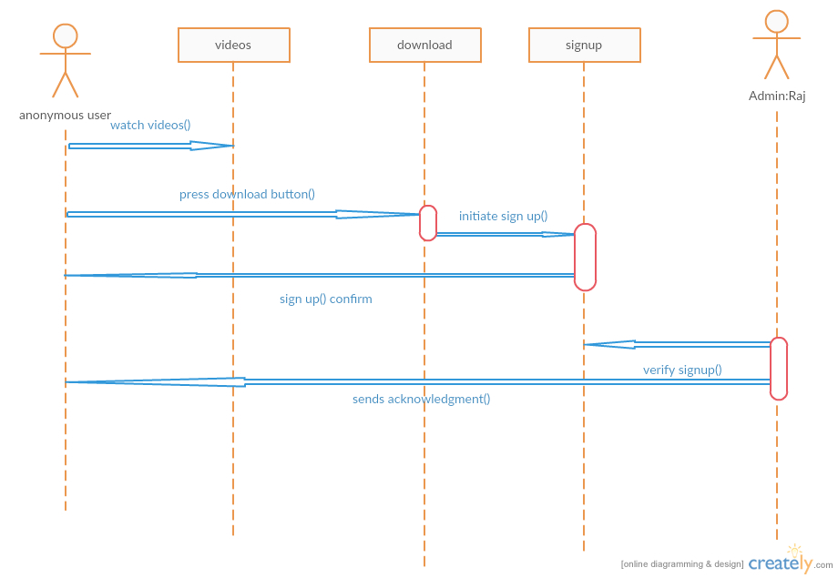
Sequence Diagram

Slide 16
Sequence Diagram
In the above sequence diagram of downloading a video (or) audio if anonymous user enter in to our system.
Anonymous user: He or she is not our user until he signed up for our system. But the anonymous user can watch or listen our videos and audios.
If anonymous user press the download button it will send him to the sign up page and if he completed the signup page the admin verifies his account and activates his account.

Slide 17
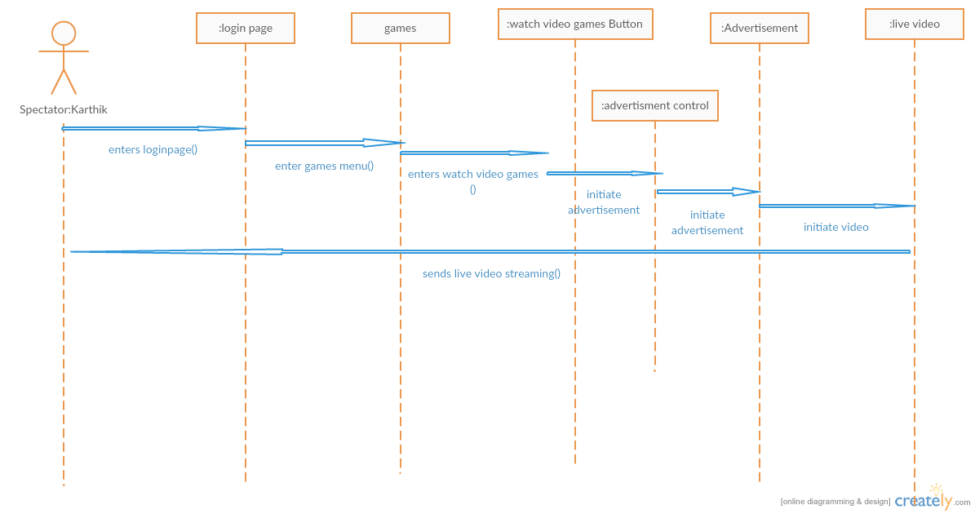
Sequence Diagram
In the above diagram spectator who becomes our user but acts as a spectator who wants to see video game. Who logins to his page and enters into game menu and press the watch video games button which was taken by advertisement control object which will initiates the advertisement and initiates the live video.

Slide 18
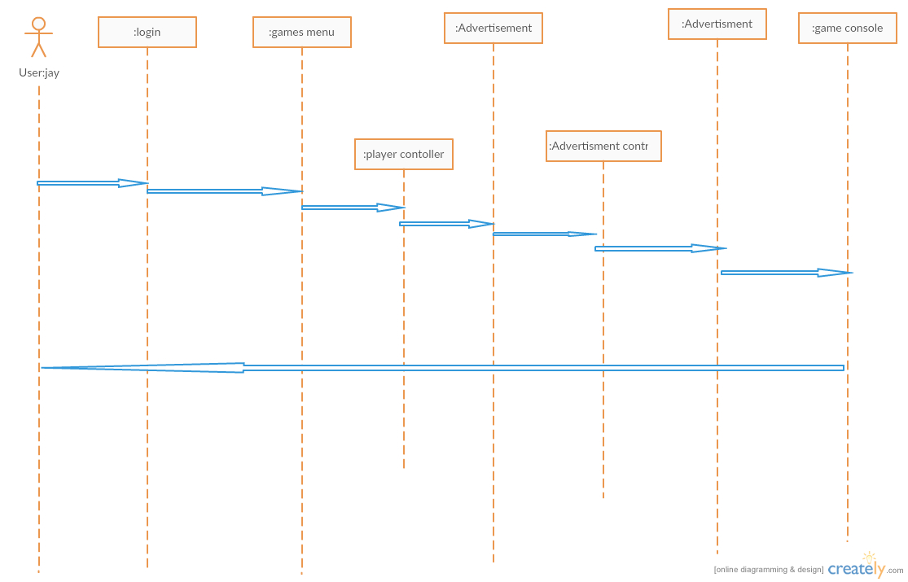
Sequence Diagram

Slide 19
Sequence Diagram
In the above sequence diagram the user jay logins to his account and games menu and enters a game which player control object will display number of players on user interface if he clicks 2 players it will initiate advertisement control object which will display certain ad which was initiated by the user.

Slide 20
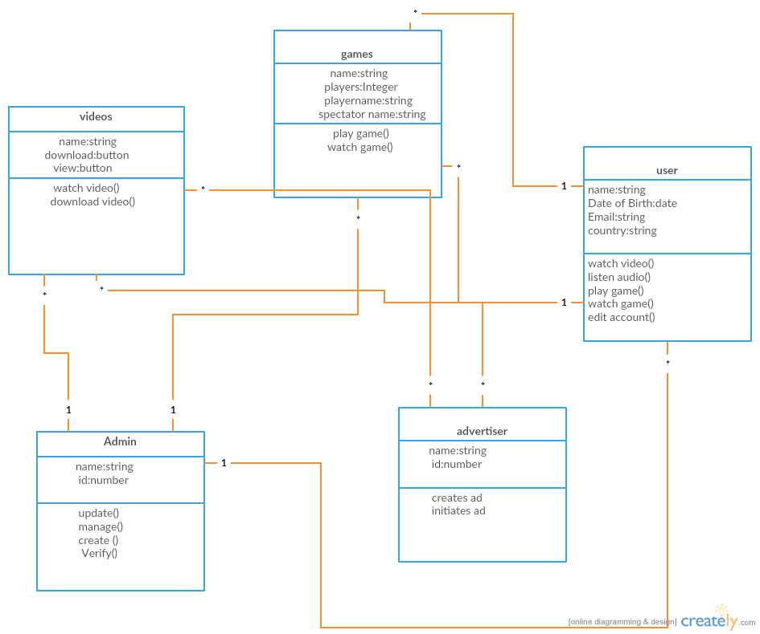
Class Diagram

Slide 21
Class Diagram
In our class diagram consists of videos, games, admin and advertiser and user class.
Videos which consists of operations watch video and download video.
Games class can do operations of play game (), watchgame ().
User can do operations like watch video and listen audio, edit account and watch game
Admin can do operations like update, manage, create, verify accounts and update videos.
Advertiser is responsible for displaying ads in front of the video.

Slide 22
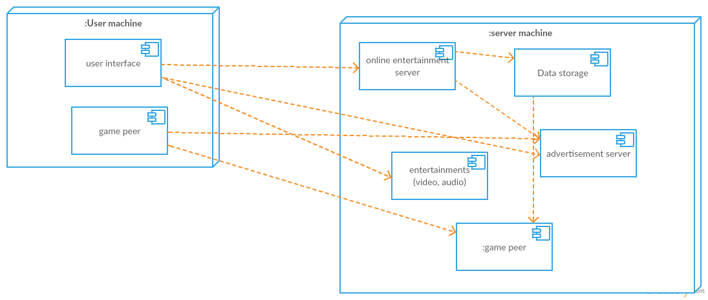
System Diagram Component Diagram:
In the above component diagram every single component has several subcomponents. In our project we consider client server architecture for entertainment purposes. And we used peer to peer connection for playing a game because a single game can be played as two players and in our application we are using a chat box for chatting when playing a game.

Slide 23
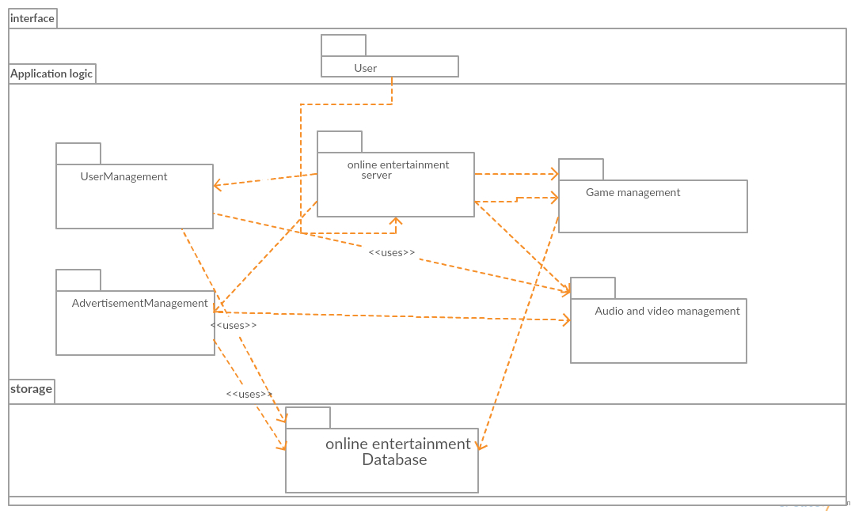
The above diagram is our online entertainment sub system decomposition where we divided in to interface and application logic and storage.

Slide 24
References
Bernd Bruegge & Allen H.Dutoit (2004) Object-Oriented Software Engineering.
A.A Puntambekar(Jan 1,2009) Software Engineering Technical Publications.

